Slide 1
Do Now
Agenda
Do Now
Objectives
Body Tissues
Epithelium
Connective
Nervous
Muscle
Tissue Repair
Closing
Please take 2 minutes to answer this question:
How do you stay “connected” with your friends and family?
How is your body connected?

Slide 2
Do Now
Agenda
Do Now
Objectives
Body Tissues
Epithelium
Connective
Nervous
Muscle
Tissue Repair
Closing
Please take 2 minutes to answer this question:
How are you preparing for the test on THURSDAY?
What are the topics that will be covered on this test?
Zip Around!

Slide 3
Do Now
Agenda
Do Now
Objectives
Body Tissues
Epithelium
Connective
Nervous
Muscle
Tissue Repair
Closing
Please take 2 minutes to answer this question:
How many basic types of tissues does the human body have?
Why do we have different tissues?
Run through the zip around again?

Slide 4
Do Now
Agenda
Do Now
Objectives
Body Tissues
Epithelium
Connective
Nervous
Muscle
Tissue Repair
Closing
Please take 2 minutes to answer this question:
What is the difference between tendons and ligaments?
Run through the zip around again?

Slide 5
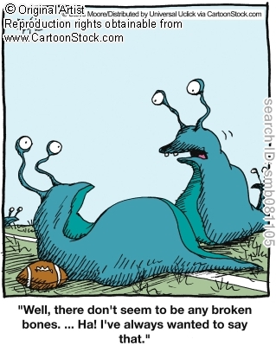
Agenda
Do Now
Objectives
Body Tissues
Epithelium
Connective
Nervous
Muscle
Tissue Repair
Closing

Slide 6
Objectives
Agenda
Do Now
Objectives
Body Tissues
Epithelium
Connective
Nervous
Muscle
Tissue Repair
Closing
Content:
Describe the four body tissues.
Correctly indentify the characteristics of each type of body tissue and locate them within the body.
Language:
Compare and contrast the four basic body tissues

Slide 7
Body Tissues
Agenda
Do Now
Objectives
Body Tissues
Epithelium
Connective
Nervous
Muscle
Tissue Repair
Closing
Cells are specialized for particular functions
Tissues
Groups of cells with similar structure and function
Four primary types
Epithelium
Connective tissue
Nervous tissue
Muscle

Slide 8
Epithelial Tissues
Agenda
Do Now
Objectives
Body Tissues
Epithelium
Connective
Nervous
Muscle
Tissue Repair
Closing
Found in different areas
Body coverings
Body linings
Glandular tissue
Functions
Protection
Absorption
Filtration
Secretion

Slide 9
Epithelium Characteristics
Agenda
Do Now
Objectives
Body Tissues
Epithelium
Connective
Nervous
Muscle
Tissue Repair
Closing
Cells fit closely together
Tissue layer always has one free surface
The lower surface is bound by a basement membrane
Avascular (have no blood supply)
Regenerate easily if well nourished

Slide 10
Classification of Epithelium
Agenda
Do Now
Objectives
Body Tissues
Epithelium
Connective
Nervous
Muscle
Tissue Repair
Closing
Number of cell layers
Simple – one layer
Stratified – more than one layer
Figure 3.17a

Slide 11
Classification of Epithelium
Agenda
Do Now
Objectives
Body Tissues
Epithelium
Connective
Nervous
Muscle
Tissue Repair
Closing
Shape of cells
Squamous – flattened
Cuboidal – cube-shaped
Columnar – column-like
Figure 3.17b

Slide 12
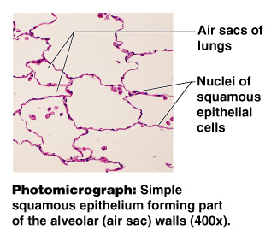
Simple Epithelium
Agenda
Do Now
Objectives
Body Tissues
Epithelium
Connective
Nervous
Muscle
Tissue Repair
Closing
Simple squamous
Single layer of flat cells
Usually forms membranes
Lines body cavities
Lines lungs and capillaries
Figure 3.18a

Slide 13
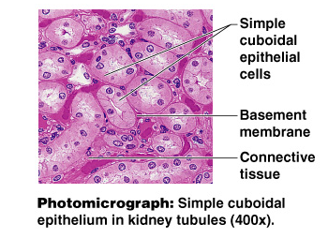
Simple Epithelium
Agenda
Do Now
Objectives
Body Tissues
Epithelium
Connective
Nervous
Muscle
Tissue Repair
Closing
Simple cuboidal
Single layer of cube-like cells
Common in glands and their ducts
Forms walls of kidney tubules
Covers the ovaries
Figure 3.18b

Slide 14
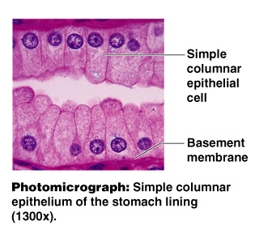
Simple Epithelium
Simple columnar
Single layer of tall cells
Often includes goblet cells, which produce mucus
Lines digestive tract
Agenda
Do Now
Objectives
Body Tissues
Epithelium
Connective
Nervous
Muscle
Tissue Repair
Closing
Figure 3.18c

Slide 15
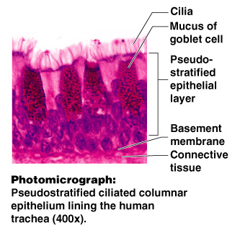
Simple Epithelium
Agenda
Do Now
Objectives
Body Tissues
Epithelium
Connective
Nervous
Muscle
Tissue Repair
Closing
Pseudostratified
Single layer, but some cells are shorter than others
Often looks like a double cell layer
Sometimes ciliated, such as in the respiratory tract
May function in absorption or secretion
Figure 3.18d

Slide 16
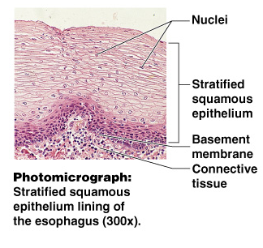
Stratified Epithelium
Stratified squamous
Cells at the free edge are flattened
Found as a protective covering where friction is common
Locations
Skin
Mouth
Esophagus
Agenda
Do Now
Objectives
Body Tissues
Epithelium
Connective
Nervous
Muscle
Tissue Repair
Closing
Figure 3.18e

Slide 17
Stratified Epithelium
Agenda
Do Now
Objectives
Body Tissues
Epithelium
Connective
Nervous
Muscle
Tissue Repair
Closing
Stratified cuboidal
Two layers of cuboidal cells
Stratified columnar
Surface cells are columnar, cells underneath vary in size and shape
Stratified cuboidal and columnar
Rare in human body
Found mainly in ducts of large glands

Slide 18
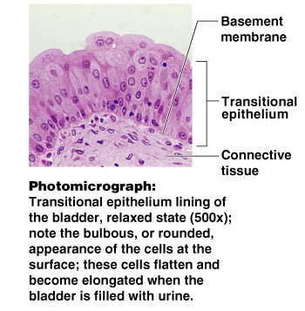
Stratified Epithelium
Agenda
Do Now
Objectives
Body Tissues
Epithelium
Connective
Nervous
Muscle
Tissue Repair
Closing
Transitional epithelium
Shape of cells depends upon the amount of stretching
Lines organs of the urinary system
Figure 3.18f

Slide 19
Glandular Epithelium
Agenda
Do Now
Objectives
Body Tissues
Epithelium
Connective
Nervous
Muscle
Tissue Repair
Closing
Gland – one or more cells that secretes a particular product
Two major gland types
Endocrine gland
Ductless
Secretions are hormones
Exocrine gland
Empty through ducts to the epithelial surface
Include sweat and oil glands

Slide 20
Connective Tissue
Agenda
Do Now
Objectives
Body Tissues
Epithelium
Connective
Nervous
Muscle
Tissue Repair
Closing
Found everywhere in the body
Includes the most abundant and widely distributed tissues
Functions
Binds body tissues together
Supports the body
Provides protection

Slide 21
Connective Tissue Characteristics
Agenda
Do Now
Objectives
Body Tissues
Epithelium
Connective
Nervous
Muscle
Tissue Repair
Closing
Variations in blood supply
Some tissue types are well vascularized
Some have poor blood supply or are avascular
Extracellular matrix
Non-living material that surrounds living cells

Slide 22
Extracellular Matrix
Agenda
Do Now
Objectives
Body Tissues
Epithelium
Connective
Nervous
Muscle
Tissue Repair
Closing
Two main elements
Ground substance – mostly water along with adhesion proteins and polysaccharide molecules
Fibers
Produced by the cells
Three types
Collagen fibers
Elastic fibers
Reticular fibers

Slide 23
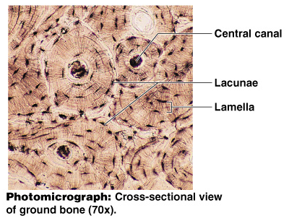
Connective Tissue Types
Agenda
Do Now
Objectives
Body Tissues
Epithelium
Connective
Nervous
Muscle
Tissue Repair
Closing
Bone (osseous tissue)
Composed of:
Bone cells in lacunae (cavities)
Hard matrix of calcium salts
Large numbers of collagen fibers
Used to protect and support the body
Figure 3.19a

Slide 24
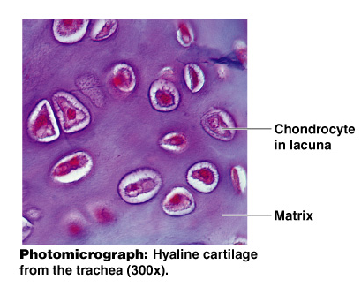
Connective Tissue Types
Agenda
Do Now
Objectives
Body Tissues
Epithelium
Connective
Nervous
Muscle
Tissue Repair
Closing
Hyaline cartilage
Most common cartilage
Composed of:
Abundant collagen fibers
Rubbery matrix
Entire fetal skeleton is hyaline cartilage
Figure 3.19b

Slide 25
Connective Tissue Types
Agenda
Do Now
Objectives
Body Tissues
Epithelium
Connective
Nervous
Muscle
Tissue Repair
Closing
Elastic cartilage
Provides elasticity
Example: supports the external ear

Slide 26
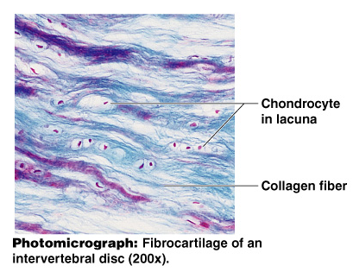
Connective Tissue Types
Agenda
Do Now
Objectives
Body Tissues
Epithelium
Connective
Nervous
Muscle
Tissue Repair
Closing
Fibrocartilage
Highly compressible
Example: forms cushion-like discs between vertebrae
Figure 3.19c

Slide 27
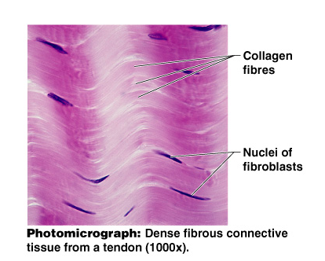
Connective Tissue Types
Dense connective tissue
Main matrix element is collagen fibers
Cells are fibroblasts
Examples
Tendon – attach muscle to bone
Ligaments – attach bone to bone
Agenda
Do Now
Objectives
Body Tissues
Epithelium
Connective
Nervous
Muscle
Tissue Repair
Closing
Figure 3.19d

Slide 28
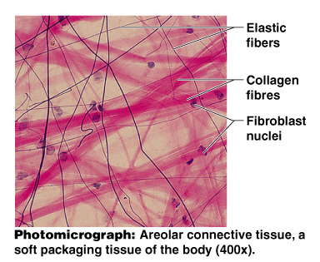
Connective Tissue Types
Agenda
Do Now
Objectives
Body Tissues
Epithelium
Connective
Nervous
Muscle
Tissue Repair
Closing
Areolar connective tissue
Most widely distributed connective tissue
Soft, pliable tissue
Contains all fiber types
Can soak up excess fluid
Figure 3.19e

Slide 29
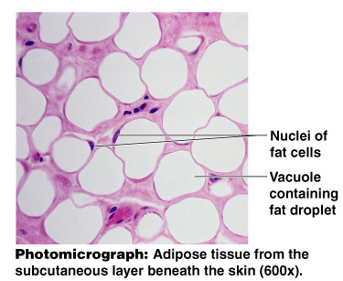
Connective Tissue Types
Adipose tissue
Matrix is an areolar tissue in which fat globules predominate
Many cells contain large lipid deposits
Functions
Insulates the body
Protects some organs
Serves as a site of fuel storage
Agenda
Do Now
Objectives
Body Tissues
Epithelium
Connective
Nervous
Muscle
Tissue Repair
Closing
Figure 3.19f

Slide 30
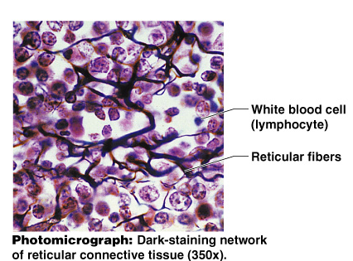
Connective Tissue Types
Agenda
Do Now
Objectives
Body Tissues
Epithelium
Connective
Nervous
Muscle
Tissue Repair
Closing
Reticular connective tissue
Delicate network of interwoven fibers
Forms stroma (internal supporting network) of lymphoid organs
Lymph nodes
Spleen
Bone marrow
Figure 3.19g

Slide 31
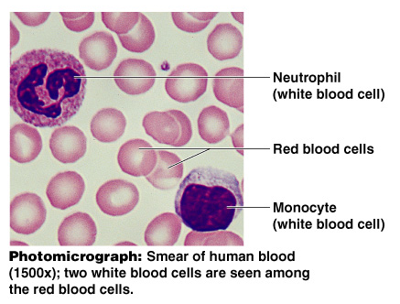
Connective Tissue Types
Blood
Blood cells surrounded by fluid matrix
Fibers are visible during clotting
Functions as the transport vehicle for materials
Agenda
Do Now
Objectives
Body Tissues
Epithelium
Connective
Nervous
Muscle
Tissue Repair
Closing
Figure 3.19h

Slide 32
Nervous Tissue
Agenda
Do Now
Objectives
Body Tissues
Epithelium
Connective
Nervous
Muscle
Tissue Repair
Closing
Neurons and nerve support cells
Function is to send impulses to other areas of the body
Irritability
Conductivity
Figure 3.21

Slide 33
Muscle Tissue
Agenda
Do Now
Objectives
Body Tissues
Epithelium
Connective
Nervous
Muscle
Tissue Repair
Closing
Function is to produce movement
Three types
Skeletal muscle
Cardiac muscle
Smooth muscle

Slide 34
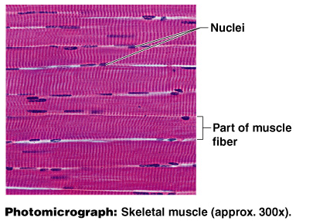
Muscle Tissue Types
Agenda
Do Now
Objectives
Body Tissues
Epithelium
Connective
Nervous
Muscle
Tissue Repair
Closing
Skeletal muscle
Can be controlled voluntarily
Cells attach to connective tissue
Cells are striated
Cells have more than one nucleus
Figure 3.20a

Slide 35
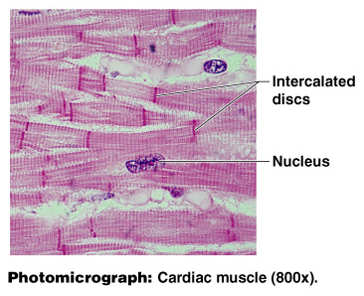
Muscle Tissue Types
Cardiac muscle
Found only in the heart
Function is to pump blood (involuntary)
Cells attached to other cardiac muscle cells at intercalated disks
Cells are striated
One nucleus per cell
Agenda
Do Now
Objectives
Body Tissues
Epithelium
Connective
Nervous
Muscle
Tissue Repair
Closing
Figure 3.20b

Slide 36
Muscle Tissue Types
Agenda
Do Now
Objectives
Body Tissues
Epithelium
Connective
Nervous
Muscle
Tissue Repair
Closing
Smooth muscle
Involuntary muscle
Surrounds hollow organs
Attached to other smooth muscle cells
No visible striations
One nucleus per cell
Figure 3.20c

Slide 37
Tissue Repair
Agenda
Do Now
Objectives
Body Tissues
Epithelium
Connective
Nervous
Muscle
Tissue Repair
Closing
Regeneration
Replacement of destroyed tissue by the same kind of cells
Fibrosis
Repair by dense fibrous connective tissue (scar tissue)
Determination of method
Type of tissue damaged
Severity of the injury

Slide 38
Events in Tissue Repair
Agenda
Do Now
Objectives
Body Tissues
Epithelium
Connective
Nervous
Muscle
Tissue Repair
Closing
Capillaries become very permeable
Introduce clotting proteins
Wall off injured area
Formation of granulation tissue
Regeneration of surface epithelium

Slide 39
Regeneration of Tissues
Agenda
Do Now
Objectives
Body Tissues
Epithelium
Connective
Nervous
Muscle
Tissue Repair
Closing
Tissues that regenerate easily
Epithelial tissue
Fibrous connective tissue and bone
Tissues that regenerate poorly
Skeletal muscle
Tissues that are replaced largely with scar tissue
Cardiac muscle
Nervous tissue within the brain and spinal cord

Slide 40
Developmental Aspects of Tissue
Agenda
Do Now
Objectives
Body Tissues
Epithelium
Connective
Nervous
Muscle
Tissue Repair
Closing
Epithelial tissue arises from all three primary germ layers
Muscle and connective tissue arise from the mesoderm
Nervous tissue arises from the ectoderm
With old age there is a decrease in mass and viability in most tissues

Slide 41
Closing/Homework
Agenda
Do Now
Objectives
Body Tissues
Epithelium
Connective
Nervous
Muscle
Tissue Repair
Closing
Content:
Describe the four body tissues.
Correctly indentify the characteristics of each type of body tissue and locate them within the body.
Language:
Compare and contrast the four basic body tissues

