Slide 1
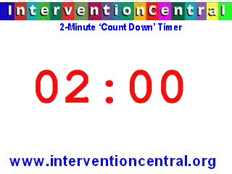
Do Now
Agenda
Do Now
Objectives
Motility
Digestion
Absorption
Circulation
Health of GI
Closing
Please take 2 minutes to answer these questions:
  When was the last time you had a problem with digestion?
  What was the problem?
  Where in the GI tract did the problem happen?

Slide 2
Do Now
Agenda
Do Now
Objectives
Motility
Digestion
Absorption
Circulation
Health of GI
Closing
Please take 2 minutes to answer these questions:
  Why do need such a strong acid in our stomachs?
  Cows have 4 stomachs, why? And why don’t we?

Slide 3
Do Now
Agenda
Do Now
Objectives
Motility
Digestion
Absorption
Circulation
Health of GI
Closing
Please take 2 minutes to answer these questions:
  How long does food last in your stomach before it is moved to the small intestine (SI)?
  How can this information be important for us to know?

Slide 4
Objectives
Agenda
Do Now
Objectives
Motility
Digestion
Absorption
Circulation
Health of GI
Closing
By the end of today’s class you will be able to:
Content:
  Distinguish among the anatomical organs of digestion.
  Differentiate between digestion, absorption and circulation.
Language:
  Orally describe the process of digestion from beginning to end.

Slide 5
Words to Know
Agenda
Do Now
Objectives
Motility
Digestion
Absorption
Circulation
Health of GI
Closing
Lumen
  Inner space within the ________
  Continuous from one end to other

Slide 6
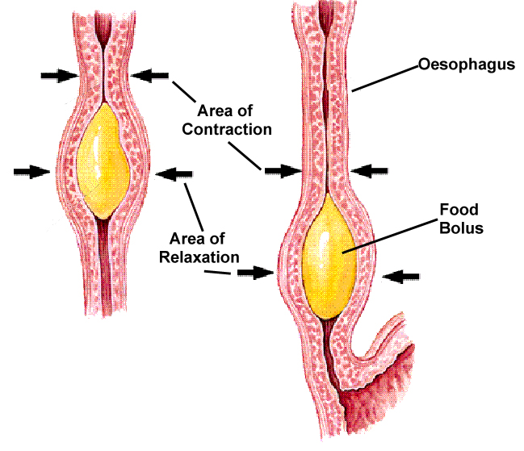
How the Food Moves- Motility
Peristalsis
  2 sets of muscles that help
    Circular muscles (inside)
    Longitudinal muscles (outside)
  Wave-like, rhythmic muscular contractions
Notes:
Think of a tube of toothpaste
Motility- ability of GI tract muscles to move
When rings tighten and long muscles relax, tube is constricted...when rings relax and long muscles tighten, tube bulges.

Slide 7
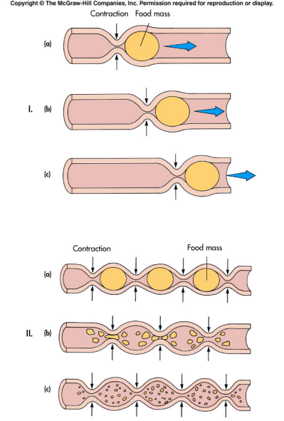
Motility
Agenda
Do Now
Objectives
Motility
Digestion
Absorption
Circulation
Health of GI
Closing

Slide 8
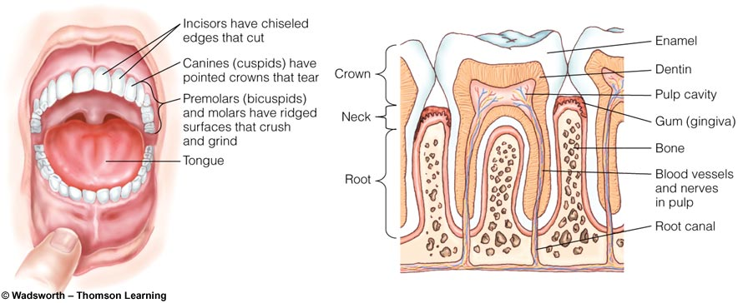
The Mouth
Agenda
Do Now
Objectives
Motility
Digestion
Absorption
Circulation
Health of GI
Closing
Flavor:
  Sweet, ____, _____, ______
  Savory (umami)
  Taste + Odor = Flavor
Process of digestion starts here
  Salivary Amylase “ase”
Notes:
Sweet sour, bitter, salty
Savory associated with monosodium glutamate (MSG)
Salivary amylase = enzyme (ase) starts to break down CHO...so if you chew a cracker for a few minutes it will start to taste sweeter b/c it is being broken down.
Enzymes = chemicals that help speed up chemical reactions. They are not changed during the process or lost (can be reused)
**Do Ritz cracker example**

Slide 9
Esophagus
Agenda
Do Now
Objectives
Motility
Digestion
Bolus travels from mouth to stomach
Sphincters:
  Upper esophageal sphincter
  Lower esophageal sphincter
GERD (Gastroesophageal Reflux Disease)
Digestion in Esophagus? ____
Notes:
Upper prevents backflow from esophagus to mouth; opens when swallowing
Lower- prevents backflow from stomach to esophagus; opens when food enters stomach
GERD—when lower sphincter doesn’t close consistently; aka “heartburn”
Try to avoid foods that cause this (spicy for example), eat more slowly, elevate your head when laying down, lose weight if overweight, etc. see pg. 97 for more

Slide 10
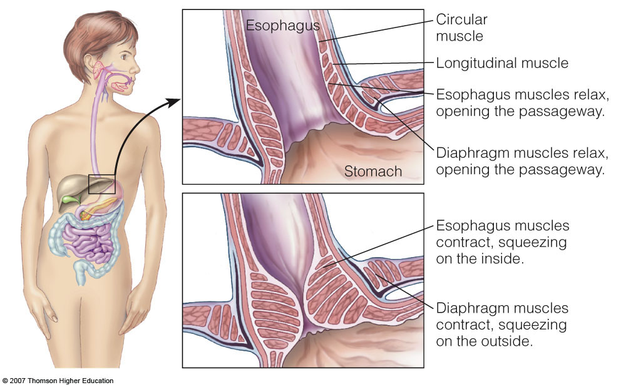

Slide 11
Stomach
Agenda
Do Now
Objectives
Motility
Digestion
Absorption
Circulation
Health of GI
Closing
Adds acids, enzymes, and fluid
Churns, mixes and grinds food to a liquid mass = Chyme
Some absorption
Store chyme until SI ready
Notes:
Absorption of water, flouride, some MCFAs, and some drugs like aspirin and alcohol into blood stream
Chyme stays in stomach about 2 hours before its released periodically into SI

Slide 12
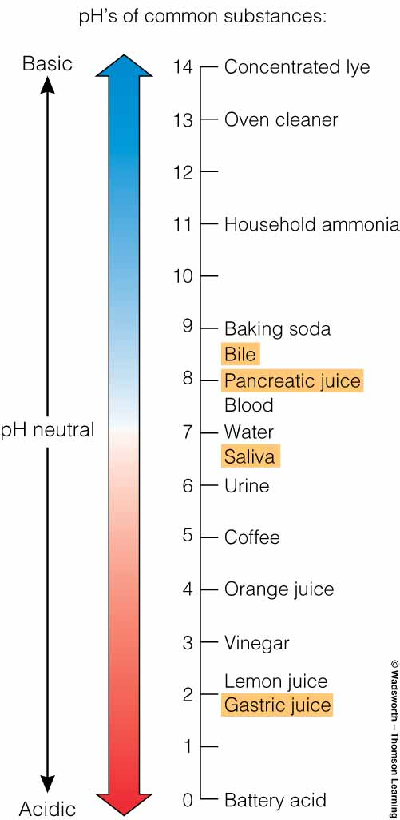
Stomach
Gastric Juices
  Hydrochloric Acid (HCl)
Intrinsic Factor (IF)
_______
Gastric Lipase
Mucus layer
Gastric Ulcer
Notes:
HCl- keeps stomach’s interior very acidic. It kills bacteria that came in with the food. Important for digestion of Protein
IF- protein critical for B12 absorption
Pepsin- enzyme. Digest proteins into smaller parts.
Gastric Lipase- enzyme responsible for lipid digestion.
Mucus layer- protects stomach from eroding itself. If there is a problem with the layer can cause gastritis or an ulcer.
Ulcer- when lining is exposed to gastric juices. NOT caused by stress or spicy foods. Caused by a bacterial infection (H. pylori), use of anti-inflammatory drugs like aspirin or IBprofin, or a disorder that causes excessive gastric excretion. Most often caused by H. pylori. See pg. 97 for more.

Slide 13
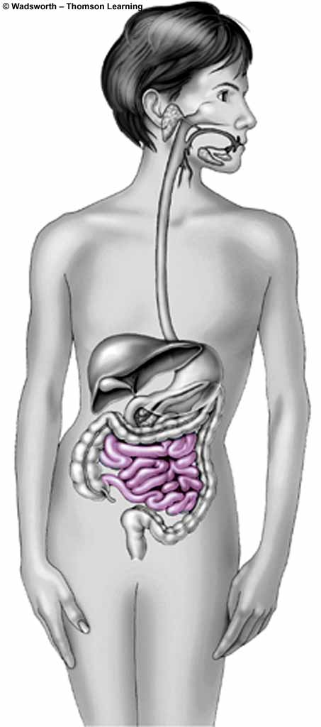
Small Intestine
Agenda
Do Now
Objectives
Motility
Digestion
Absorption
Circulation
Health of GI
Closing
Duodenum
  ~1 foot
  Primary site of digestion
Jejunum
  ~____ feet
Ileum
  ~5 feet
Notes:
Jejunum 4’

Slide 14
Small Intestine
Agenda
Do Now
Objectives
Motility
Digestion
Absorption
Circulation
Health of GI
Closing
Enzymes
  Pancreatic Juices
  Intestinal Wall enzymes
Bicarbonate
Bile
  Produced by ___________
  Stored in ______________
  Emulsifier _____________
Ileocecal Valve
Notes:
Pancreatic juice—contains enzymes that ct on all three E nutrients
Intestinal wall also has digestive enzymes on the surface
Bicarbonate---sodium bicarbonate, basic/alkaline, opposite of stomach’s acid. This pancreatic juice neutralizes the acidic chyme arriving in the SI from the stomach, so the chyme is then neutral and so the enzymes can work best in this enviornment.
Bile—produced by liver, stored in gallbladder, goes into duodenum when fat goes to SI. Is an emulsifier, so the fat can be suspended with water.
Ileocecal valve—separates sm. And lg. intestines

Slide 15
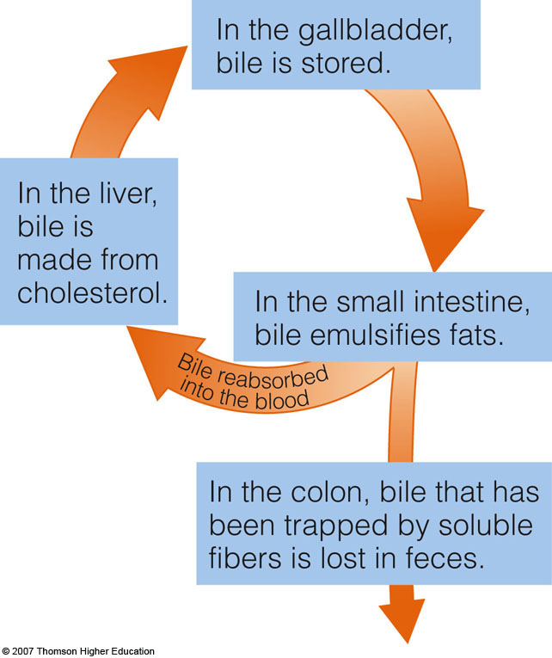
Path of Bile
Agenda
Do Now
Objectives
Motility
Digestion
Absorption
Circulation
Health of GI
Closing

Slide 16
Large Intestine (Colon)
Agenda
Do Now
Objectives
Motility
Digestion
Absorption
Circulation
Health of GI
Closing
Little digestion here
Mostly water, body secretions and undigested material (fiber)
Intestinal Flora
  Ferment some fiber, producing
    ______
    Gas (flatulence)
    Energy for cells of the colon
Diverticulosis
Notes:
Produces water
Energy produced by small fragments of fat that provide the E for cells of the colon.
Diverticulosis—condition in which the intestinal walls develop bulges in weakened areas (most commonly in colon, but can develop anywhere along GI tract). These bulging pockets (diverticula) can worsen constipation, entrap feces, and become painfully infected and inflammed (diverticulitis). Tx includes hospitalization, antibiotics, or surgery. Often people with this need to avoid small foods like corn, nuts and seeds.

Slide 17
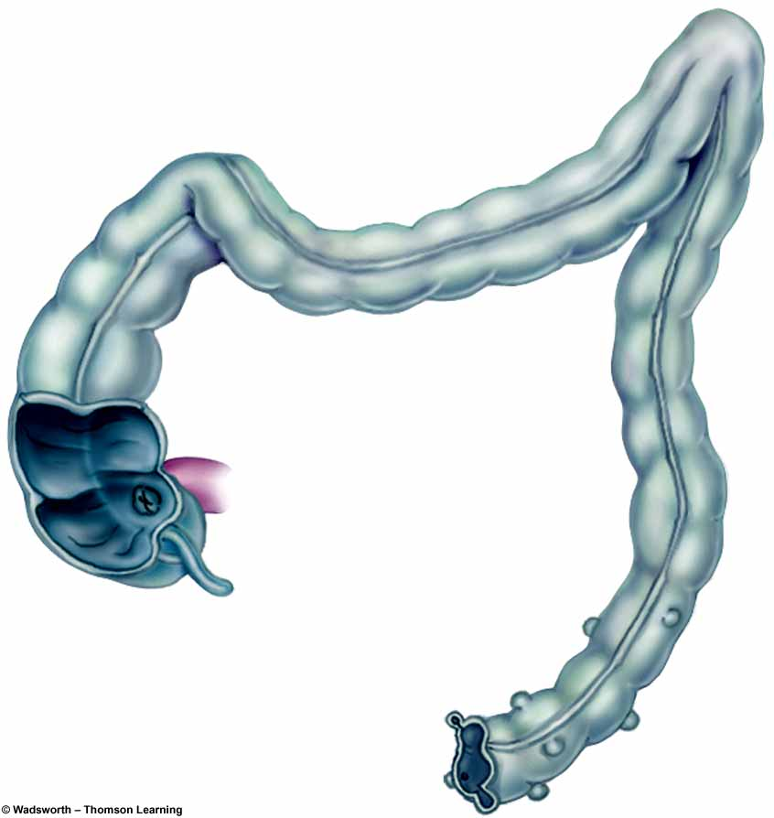
Large Intestine (Colon)
Agenda
Do Now
Objectives
Motility
Digestion
Absorption
Circulation
Health of GI
Closing
Diverticula (plural)
Notes:
Produces water
Energy produced by small fragments of fat that provide the E for cells of the colon.
Diverticulosis—condition in which the intestinal walls develop bulges in weakened areas (most commonly in colon, but can develop anywhere along GI tract). These bulging pockets (diverticula) can worsen constipation, entrap feces, and become painfully infected and inflammed (diverticulitis). Tx includes hospitalization, antibiotics, or surgery. Often people with this need to avoid small foods like corn, nuts and seeds.

Slide 18
Recap Digestion
Agenda
Do Now
Objectives
Motility
Digestion
Absorption
Circulation
Health of GI
Closing
Mouth
  Salivary Amylase for starch
Stomach
  HCl and Pepsin for Protein uncoiling
  Gastric Lipase for ______
SI--where most digestion occurs
  Pancreatic and Intestinal enzymes for starch
  Bile for lipid
  Protein digested
Large Intestine
Notes:
Lipase for lipid

Slide 19
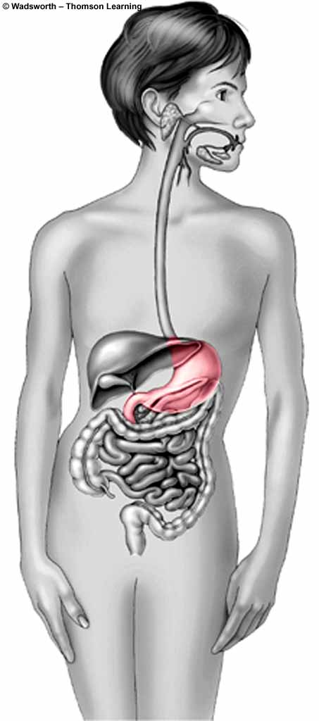
In the Stomach
II. Absorption:
Agenda
Do Now
Objectives
Motility
Digestion
Absorption
Circulation
Health of GI
Closing
Water
Alcohol
Small Lipids

Slide 20
In the Small Intestine
Agenda
Do Now
Objectives
Motility
Digestion
Absorption
Circulation
Health of GI
Closing
Villi
  Finger-like projections
Microvilli
  On the Villi
The more surface area, the better the absorption!
Celiac’s Disease
Notes:
Celiac’s disease: when a person’s immune system reacts to gluten (protein in wheat, rye and barley products) by making the SI inflamed. When inflamed, the villi go flat, and not as much nutrients are absorbed.

Slide 21
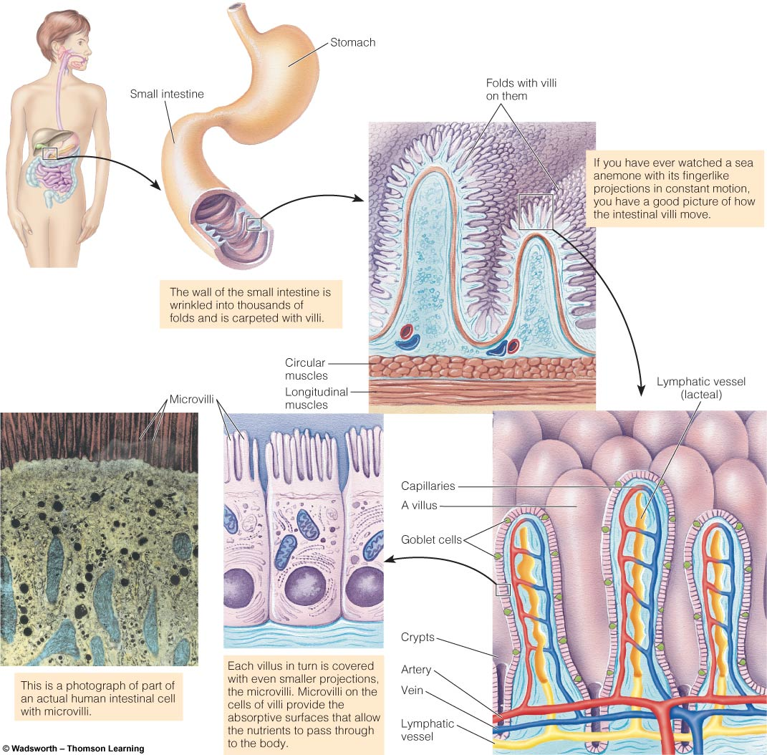
Agenda
Do Now
Objectives
Motility
Digestion
Absorption
Circulation
Health of GI
Closing
Microvilli
Villi
Notes:
Celiac’s disease: when a person’s immune system reacts to gluten (protein in wheat, rye and barley products) by making the SI inflamed. When inflamed, the villi go flat, and not as much nutrients are absorbed.

Slide 22
Agenda
Do Now
Objectives
Motility
Digestion
Absorption
Circulation
Health of GI
Closing
Villi
Water-soluble
Fat-soluble
Bloodstream
Lymphatic
system

Slide 23
Types of Absorption
Agenda
Do Now
Objectives
Motility
Digestion
Absorption
Circulation
Health of GI
Closing
Simple Diffusion
  No Energy, No Carrier
  Movement from high to low concentration
Facilitated Diffusion
  No Energy, __________
  Move from high to low concentration
Active Transport
  Need Energy (ATP) and Need Carrier
  Low to high concentration
Notes:
Simple diffusion—water, small lipids. Cross intestinal cells freely
Facilitated diffusion—water-sol vit. Need specific carrier to transport them from one side of cell membrane to other
Active Transport—glucose and AA. Move against the concentration gradient, so need E to do

Slide 24
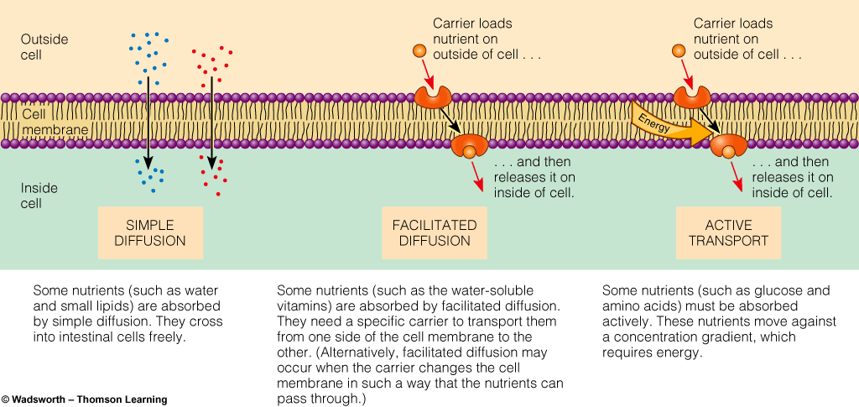
Types of Absorption
Copyright 2005 Wadsworth Group, a division of Thomson Learning

Slide 25
In Large Intestine (colon)
Agenda
Do Now
Objectives
Motility
Digestion
Absorption
Circulation
Health of GI
Closing
Absorption (reabsorption)
  Water and some minerals
Feces

Slide 26
ORGAN | FUNCTIONS
Mouth | Chewing Digestion of starch
Esophagus | Passage way
Stomach | Food Storage Acid kills bacteria Some protein digestion
Small Intestine | Final digestion Absorption
Large Intestine | Absorption of water, minerals
Anus | Elimination
Liver | Production of bile
Gallbladder | Store and release bile
Pancreas | Enzymes and bicarbonate
Agenda
Do Now
Objectives
Motility
Digestion
Absorption
Circulation
Health of GI
Closing

Slide 27
Video…

Slide 28
The Circulatory Systems
III. Transport:
Agenda
Do Now
Objectives
Motility
Digestion
Absorption
Circulation
Health of GI
Closing
The Vascular System
The Lymphatic System

Slide 29
The Vascular System
Agenda
Do Now
Objectives
Motility
Digestion
Absorption
Circulation
Health of GI
Closing
Blood circulation
Heart is the pump
Blood
  Provides O₂ and nutrients
  Picks up CO₂ and ________
Lungs
  Exchange CO₂ and O₂
Digestive System
  Supplies nutrients to be picked up
Notes:
Picks up CO2 and waste
As blood circulates, it picks up and delivers materials as needed

Slide 30
The Route of Blood to Body
Agenda
Do Now
Objectives
Motility
Digestion
Absorption
Circulation
Health of GI
Closing
Blood leaves RIGHT side of heart
Circulates through lungs- gas exchanged
Enters LEFT side of heart
Out the Aorta to Arteries throughout body
Arteries to Capillaries- exchange with cells
Vein return blood to RIGHT side of heart

Slide 31

Agenda
Do Now
Objectives
Motility
Digestion
Absorption
Circulation
Health of GI
Closing
Arteries
Veins
Notes:
*handout

Slide 32
The Route of Blood to
Digestive System
Agenda
Do Now
Objectives
Motility
Digestion
Absorption
Circulation
Health of GI
Closing
Out of Aorta to Arteries to Capillaries
To leave digestive system
  Hepatic portal vein to capillaries to LIVER
  Leaves Liver by Hepatic Vein to Heart

Slide 33

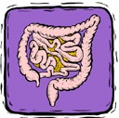
Agenda
Do Now
Objectives
Motility
Digestion
Absorption
Circulation
Health of GI
Closing
Arteries to Capillaries
Hepatic Vein
Hepatic Portal Vein
Notes:
Hepatic portal vein directs blood to liver
Liver protects the rest of your body from harmful substances (excess liver, drugs, viruses like hepatitis, etc)

Slide 34
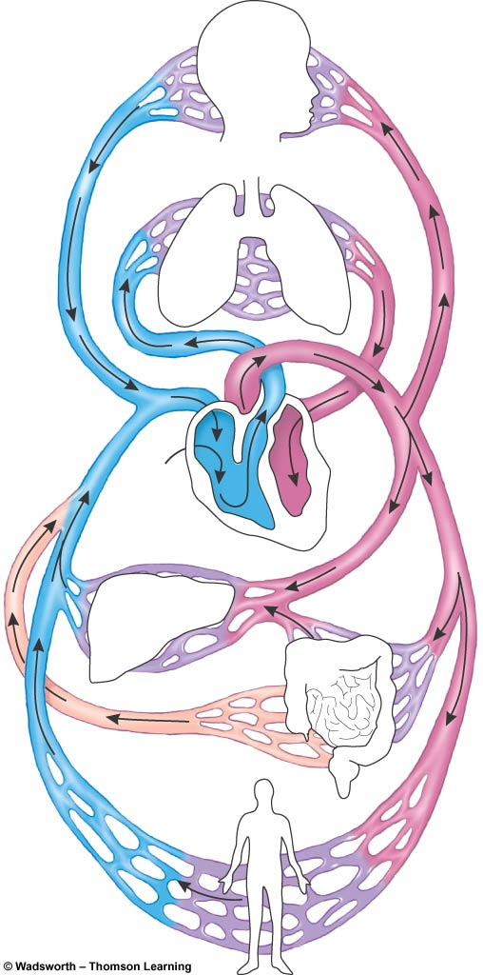
The Vascular System
Head and
upper
body
Agenda
Do Now
Objectives
Motility
Digestion
Absorption
Circulation
Health of GI
Closing
Lungs
2
Pulmonary vein
Pulmonary artery
Aorta
3
1
Aorta
Left
side
4
Left
side
7
Right
side
Heart
Heart
Hepatic artery
5
Hepatic artery
Hepatic vein
Portal vein
Liver
Portal vein
Digestive
tract
= Arteries
= Capillaries
= Veins
= Lymph vessels
Digestive
tract
6
Lymph
Entire body
Notes:
Blood leaves the right side of the heart by way of the pulmonary artery.
Blood loses CO2 and picks up O2 in the lungs and returns to the left side of the heart by way of the pulmonary vein.
Blood leaves the left side of the heart by way of the aorta, the main artery that launches blood on its course through the body
Blood may leave the aorta to go to the upper body and head OR blood may leave the aorta to go to the lower body
Blood may go to the digestive tract and then the liver OR blood may go to the pelvis, kidneys, and legs
Blood returns to the right side of the heart
Lymph from most of the body’s organs, including the digestive system, enters the bloodstream near the heart

Slide 35
The Lymphatic System
Agenda
Do Now
Objectives
Motility
Digestion
Absorption
Circulation
Health of GI
Closing
One-way route for fluid from tissue spaces to enter blood
Lymph fluid
  Transports fat and fat-soluble vitamins
Digestive tract Veins Heart
  Bypass _______
Notes:
So fat in digestive tract does not go through liver initially.

Slide 36
Health and Regulation of GI Tract
Agenda
Do Now
Objectives
Motility
Digestion
Absorption
Circulation
Health of GI
Closing
Prebiotics
  Pre =
  Examples:
Probiotics
  Pro=
  Examples:
Notes:
Pg. 86
Pre – before
examples: fiber; food for the bacteria to encourage bacterial growth
Pro = life
examples: yogurt; live Mos found in food that have health benefits

Slide 37
Closing/Homework
Agenda
Do Now
Objectives
Motility
Digestion
Absorption
Circulation
Health of GI
Closing
Can you do this now?
Content:
  Distinguish among the anatomical organs of digestion.
  Differentiate between digestion, absorption and circulation.
Language:
  Orally describe the process of digestion from beginning to end.

